Slide 1
Intrusion detection system
Abdulmajeed Alroumi

Slide 2

Introduction
What is Intrusion detection system?
Datasets

Slide 3
Problem Statement
Malcious file
Detect if they Bengin or Ddos

Slide 4
Imblanced data
Benign
DDos

Slide 5
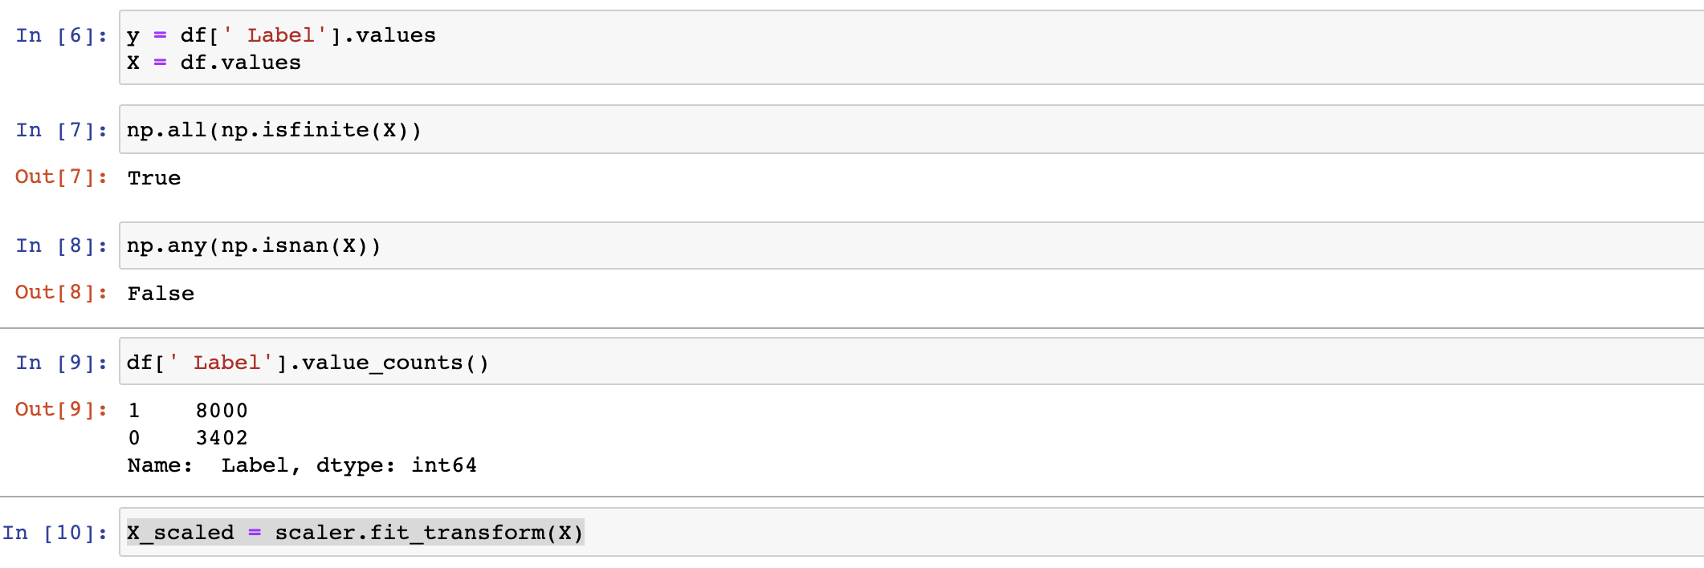
Scale

Slide 6
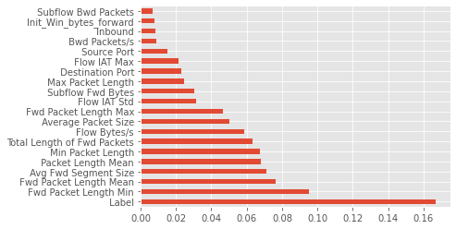
Feature importance
(pd.Series(model.feature_importances_, index=df.columns)
.nlargest(20)
.plot(kind='barh'))

Slide 7
Feature
Source Port
Protocol

Slide 8
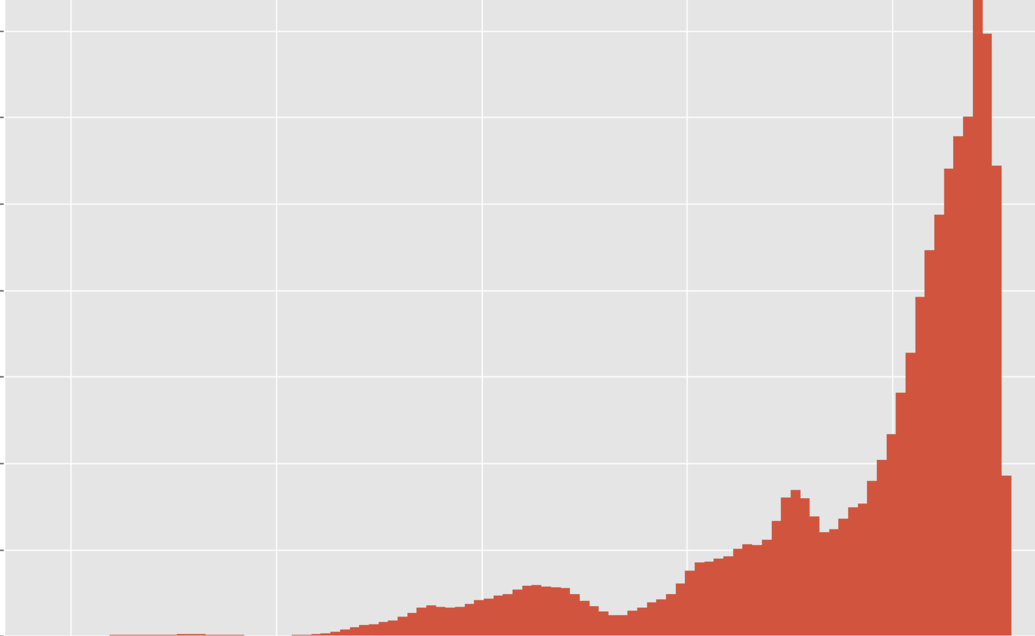
Benging vs DDos

Slide 9
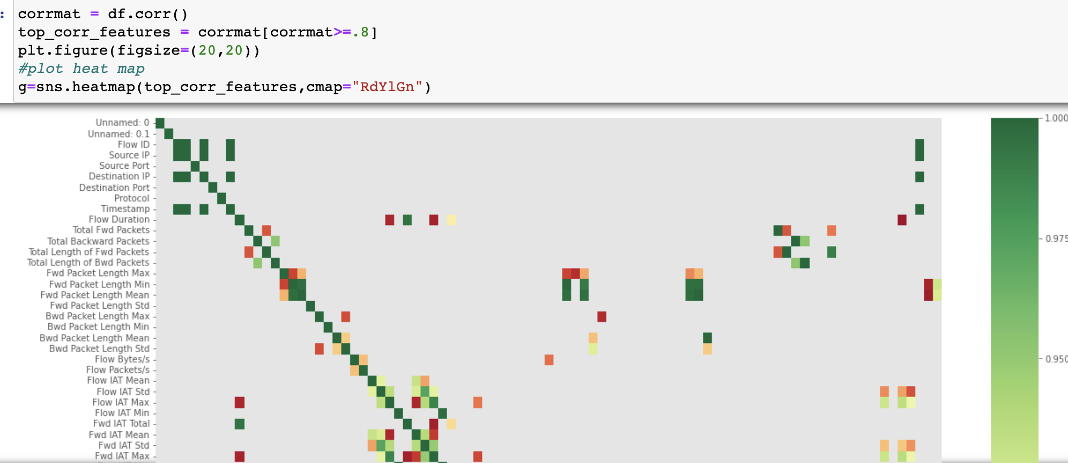
PCA

Slide 10
The model
RNN
LSTM
Transformer

Slide 11
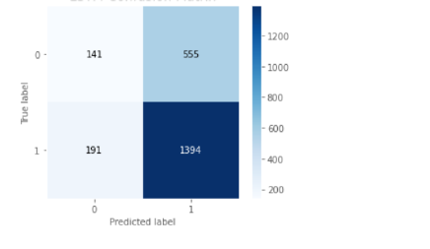
RNN
Accuracy: 67.30%

Slide 12
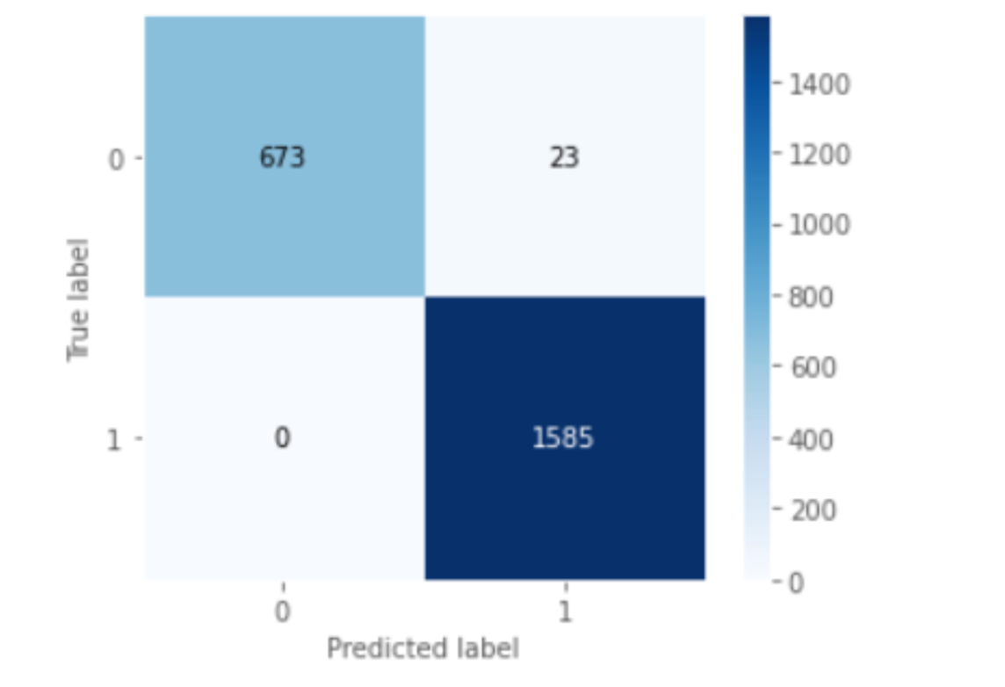
LSTM
Accuracy: 98.99%

Slide 13

Why choose NLP?

Slide 14
Next
Perfform transformer
Deploy the model

Slide 15
Questions?

